Slide 1
Using Classification Models to Determine How To Win Soccer Games In Europe
Mitchell Gil

Slide 2
The Problem
How to best predict what attributes and properties of a team will best contribute towards a game win in European soccer?

Slide 3
StakeHolders
European Soccer Coaches looking to further improve their team

Slide 4
Data Information
Original dataset when merged contained 25k matches and around 200 columns of potential features.
This was spread across seven different SQL tables.
Some of the attributes were in XML format
Match data was sourced from official FIFA records, player attributes were sourced from EA FIFA 2016 Video Game.
Match data also contains betting odds from 10 different gambling sites.

Slide 5
Data Exploration
Over 55% of the Data contained NaN values across multiple features
The 45% of the dataset that was complete was kept. This still left around 12,000 rows of data to work with.
Most of the features except for some goalkeeper attributes were within normal distribution

Slide 6
Data Models Chosen
Problem is a Multiple Classification Problem (Win, Draw, loss)
Used Common Sci-kit-Learn Classification Models
KnearestClassifier
RandomForestClassifier
Support Vector Machines
Logistic regression

Slide 7
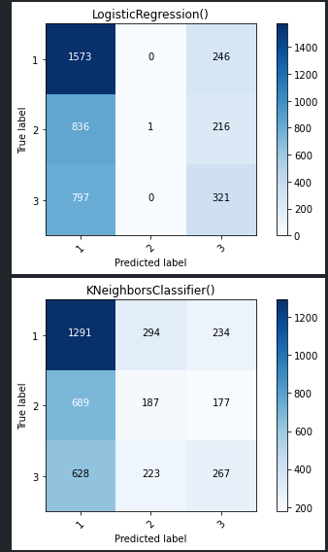
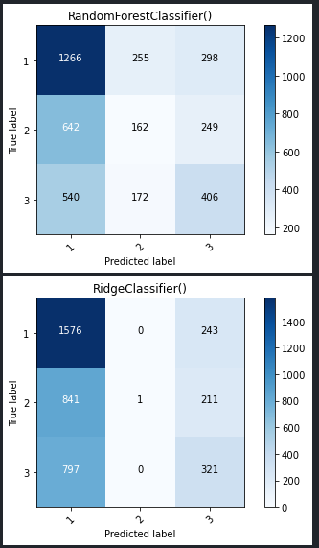
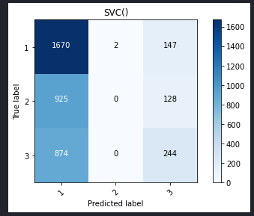
Initial Modeling

Slide 8
Initial Modeling (Cont)
Metrics:
LogisticRegression() score: 0.474937343358396 accuracy: 0.4880232840164929
KNeighborsClassifier() score: 0.43734335839599 accuracy: 0.4406395019807584
RandomForestClassifier() score: 0.45964912280701753 accuracy: 0.46202245244447526
RidgeClassifier() score: 0.4756892230576441 accuracy: 0.4874863425845721
SVC() score: 0.47969924812030074 accuracy: 0.49081771248397493

Slide 9
Model Tuning
Took over two hours to tune.
Scores virtually within the argin of error on tuned models vs untuned..
Average model score was still close to 49% just like the untuned models.

Slide 10
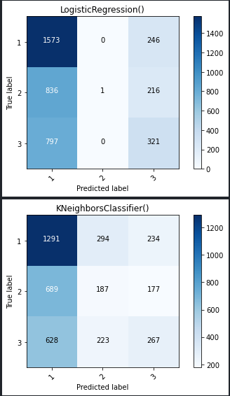
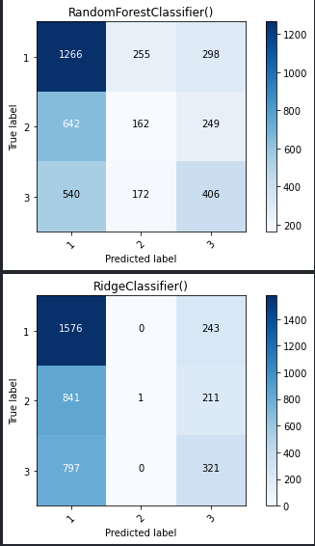
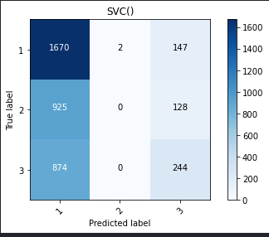
Model Tuning

Slide 11
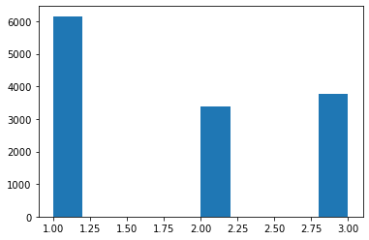
Model Tuning

Slide 12
Model Tuning
SelectKBest(k=44) LogisticRegression(max_iter=50, n_jobs=-1) score: 0.4928559019410813
SelectKBest(k=9) KNeighborsClassifier(leaf_size=5, n_jobs=-1, n_neighbors=100) score: 0.49435914188634245
SelectKBest(k=4) RandomForestClassifier(max_depth=5, max_leaf_nodes=20, n_estimators=20,n_jobs=-1) score: 0.4986564053489831
SelectKBest(k=60) RidgeClassifier() score: 0.49382243126046477
SelectKBest(k=42) SVC() score: 0.5056408003966314

Slide 13
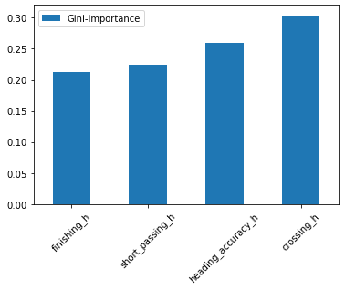
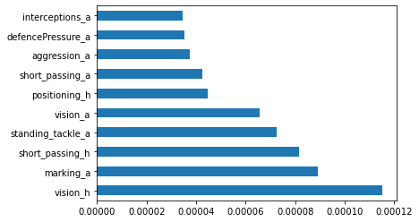
Findings

Slide 14
Findings
buildUpPlayPassing_h 81.907244
defencePressure_a 77.684631
buildUpPlayPassing_a 76.626319
defencePressure_h 68.157454
chanceCreationShooting_h 30.724597
interceptions_a 28.603195
chanceCreationShooting_a 28.168730
possession_h 15.194224

Slide 15
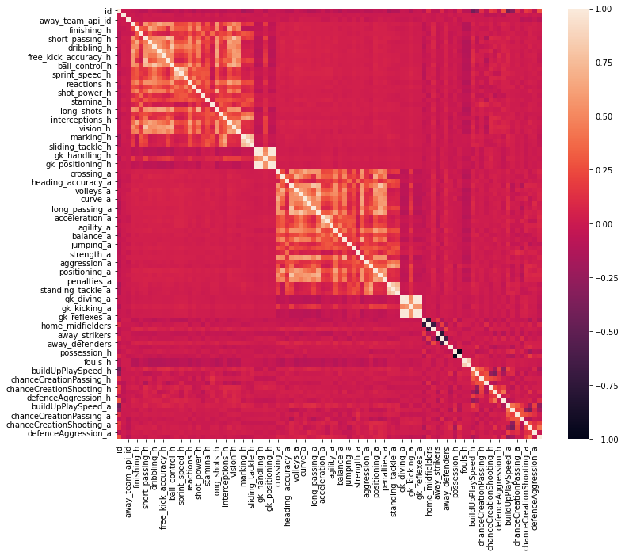
Findings

Slide 16
Findings
I used all four classification models to find the important features used to tune them. This is the result of all of them having an equal accuracy score of around 49%.
Correlation heatmap shows features each model prefered were correlated.
The models all heavily favor home team as the winner
Most of the favorable features also heavily lean towards the home team, so they accurately reflect what attributes the home team had to contribute to the win.

Slide 17
Findings
Attributes related to defensive pressure and buildup passing show up across multiple feature importances in the different models.
Although the models are inaccurate, the attributes make sense from a tactical standpoint. Teams need to be incredibly coordinated in order to perform better than the opposing team to win their respective game.
Passing during the buildup and pressue against the defence are reflections of that coordination.

Slide 18
Findings
Random Forest prefered features related to average individual player statistics rather than team attributes, but even those are a reflection of the findings of the other models. Two of the attributes are passing relatyed, and the “header accuracy” attribute is the result of receiving the pass with the head and slotting it into goal.

Slide 19
Conclusion
Based on multiple classification models , teams with great passing, with players who are great passers, are more likely to win their games against teams who cannot pass as well. The raw dataset also suggests there is a home team advantage to the game as well, though the models pronounce this advantge a bit too much

